Slide 1

Stock market trend prediction using Machine Learning approach
Team: Anup Nair, Anup Kumar, Lokesh Sharma, Rahul Sharma
Mentor: Dr. D. Narayana

Slide 2
Agenda
Introduction
Tools, Infrastructure and Software Packages
Data Preparation and EDA
Stock Prediction Algorithm and Methodology
Sentiment Mining Modeling Approach
Models Evaluated and Validation Measures
Output Visualization
Conclusion and Next Steps

Slide 3



Introduction
Problem Statement, Project Objectives and Scope
Problem Statement
Project Objectives
Scope
Ability to predict stock price direction (even with accuracy slightly better than random guessing) can yield significant financial returns
The project aims at constructing features which carry predictive information using company specific news from online mediums and marry them with historical data to identify the direction of stock price movement
Stock Selection: We have limited
Our project leverages Machine Learning based models and approaches to predict Stock Market trends and performance
Traditional approaches to stock prediction rely on data driven qualitative approaches or rule based techniques
ourselves to Index stocks (BSE
30) – Separate models are
developed for each stock in the
Index
Duration: our project focused on
short term prediction. The objective
was to predict next day’s stock
movement direction (up or down)
for a given stock
3

Slide 4
Agenda
Introduction
Tools, Infrastructure and Software Packages
Data Gathering, Preparation and EDA
Stock Prediction Algorithm and Methodology
Sentiment Mining Modeling Approach
Models Evaluated and Validation Measures
Output Visualization
Conclusion and Next Steps

Slide 5



Tools, Infrastructure and Software Packages Used
A variety of different tools, software packages and computational infrastructure leveraged for project completion
Stock Prediction Model
Sentiment Mining Model
Visualization
Python was used as the core programming language for data processing and model development
Machine Learning models were developed using both scikit-learn as well as Spark ML library (using PySpark)
For Sentiment Mining, we explored computationally intensive Deep Learning Models (RNN/CNN)
To ensure fast processing, GPU processors (via Amazon EC2) was leveraged
Python’s Keras library was used for implementing the DL models
R Shiny based app was used for Exploratory Data Analysis (EDA)
Tableau was used for final output visualization

Slide 6
Agenda
Introduction
Tools, Infrastructure and Software Packages
Data Gathering, Preparation and EDA
Stock Prediction Algorithm and Methodology
Sentiment Mining Modeling Approach
Models Evaluated and Validation Measures
Output Visualization
Conclusion and Next Steps

Slide 7
Data Gathering
Broadly, 2 different data sources were required for the project – (1) Historical Stock prices for selected stocks (BSE 30 index stocks) (2) News Articles for Sentiment Mining
Historical Stock Prices data
News Articles
Daily stock prices information was extracted from Quandl (using their Python API) for BSE 30 index stocks
The extracted data was saved as a Python dictionary and stored on the disk as a pickled object, for subsequent analysis
News articles were scraped from “The Hindu” newspaper for the last 5 years (using relevant libraries in Python – BeautifulSoup, Request etc)
Only articles which were tagged under “Business” section were scraped. This resulted in ~50k articles being scraped

Slide 8

Data Preparation & Feature Engineering
Lag Features
Lag features were created by considering previous days’ closing prices (Last 10 days closing prices considered)
Absolute prices were then converted to percentage changes
Step-by-Step Approach
Technical Indicators as Features
Instead of only considering lag prices as features, key Technical indicators were also computed and fed in as additional set of features
Multiple different Technical Indicators considered as features such as Relative Strength Index, William’s R, MACD etc
Sentiment Scores as Feature
Sentiment mining model trained on a publicly available labeled data set
Model used to score news articles on their sentiment. Only news articles mentioning the Company name considered for analysis
Target Variable Creation
Target variable is defined as the direction of the price movement between next day and prior day closing price (i.e “1” if price goes up else 0)

Slide 9
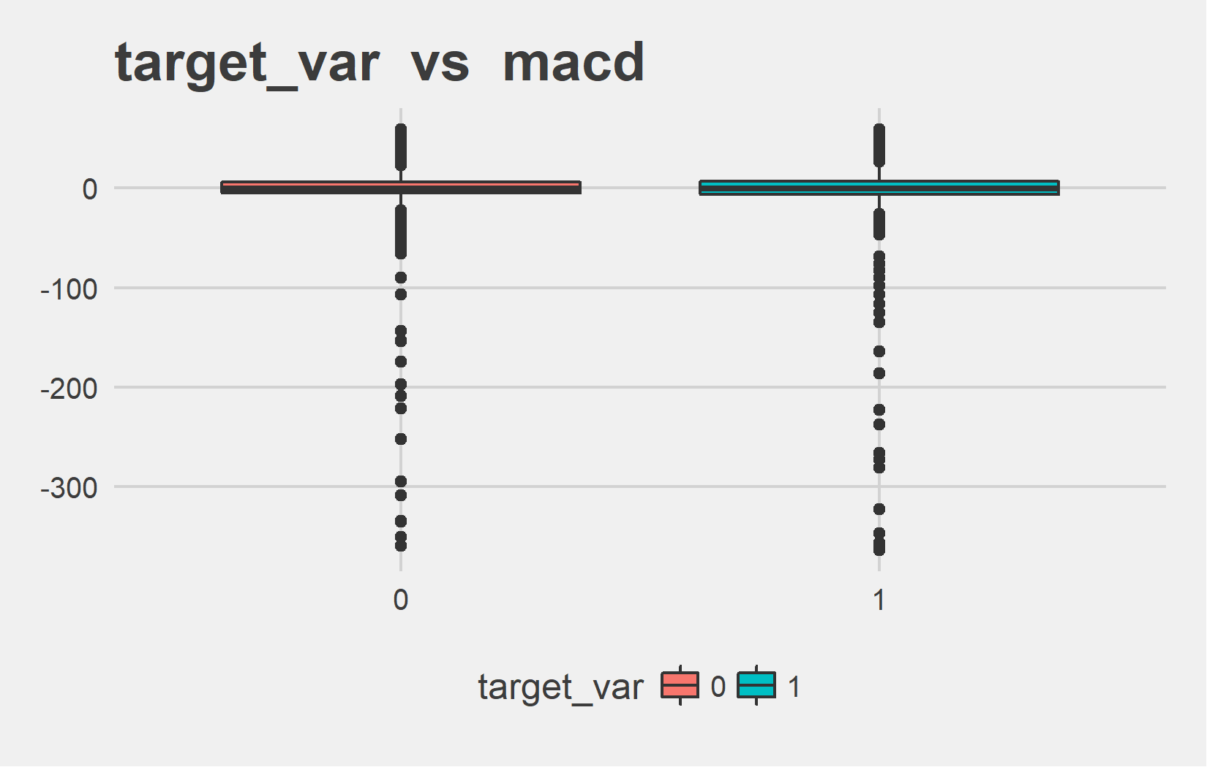
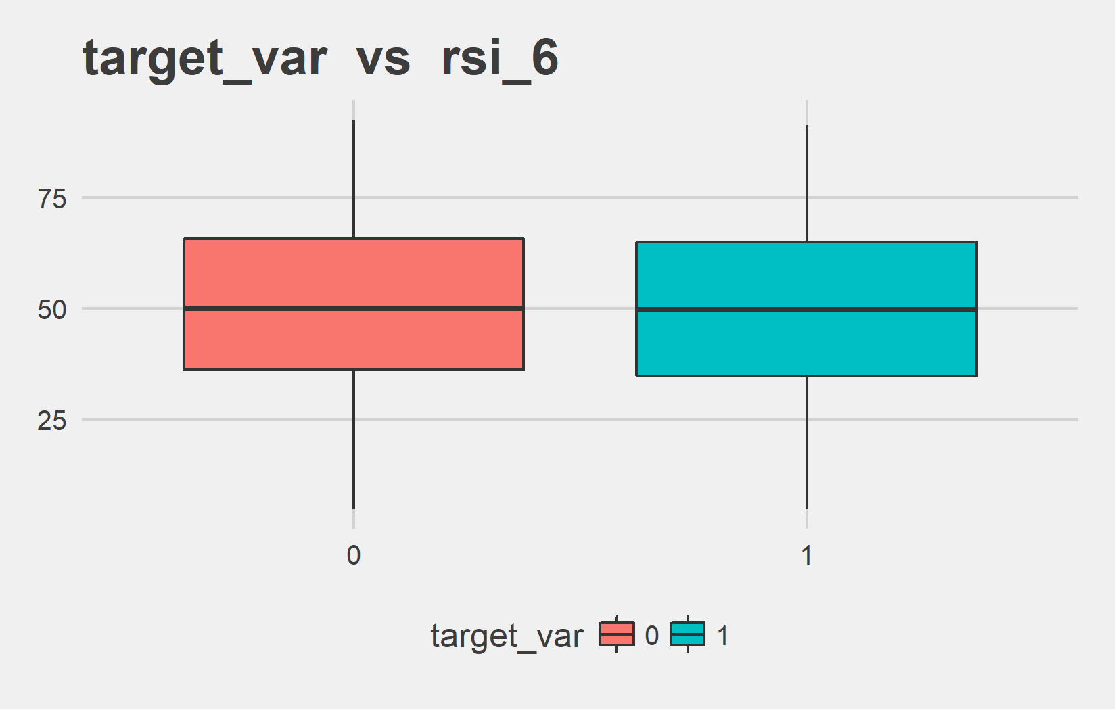
Exploratory Data Analysis
Exploratory Data Analysis (EDA) was performed to gain initial understanding of the relationship between the features and the target variable
Sample EDA plots for “ICICI” stock model
target_var | mean - macd | median - macd
0 | -2.81 | -0.21
1 | -5.43 | -0.26
target_var | mean - rsi_6 | median - rsi_6
0 | 50.69 | 50.03
1 | 49.71 | 49.75

Slide 10
Agenda
Introduction
Tools, Infrastructure and Software Packages
Data Gathering, Preparation and EDA
Stock Prediction Algorithm and Methodology
Sentiment Mining Modeling Approach
Models Evaluated and Validation Measures
Output Visualization
Conclusion and Next Steps

Slide 11
Stock Prediction Approach
High Level Schema
Data Gathering
Extract historical end of day stock prices data from Qandl for BSE 30 Stocks
Create Lag Features
Prediction problem set up by considering past prices as lag features. E.g predict price at time t as a function of prices from t-1 to t-5 days. Instead of predicting absolute prices, price direction considered (Classification Problem)
Create Technical Indicator features
Add Technical Indicators as additional features to enhance model accuracy
Create Sentiment Feature
Sentiment scores basis news articles fed in as additional set of features
Model Training and Validation
Model Training and Validation

Slide 12
Technical Indicators are Features
To enhance model accuracy, Technical Indicators were fed in as additional features
Relative Strength Index (RSI)
RSI is a momentum oscillator that measures the speed and change of price movements
RSI = 100 – [100 / ( 1 + (Average of Upward Price Change / Average of Downward Price Change ) ) ]
Key Technical Indicators
William’s R
This is a momentum indicator that measures overbought and oversold levels
%R = (Highest High – Closing Price) / (Highest High – Lowest Low) x -100
MACD
Moving average convergence divergence (MACD) is a trend-following momentum indicator that shows the relationship between two moving averages of prices. The MACD is calculated by subtracting the 26-day exponential moving average (EMA) from the 12-day EMA.

Slide 13
Agenda
Introduction
Tools, Infrastructure and Software Packages
Data Gathering, Preparation and EDA
Stock Prediction Algorithm and Methodology
Sentiment Mining Modeling Approach
Models Evaluated and Validation Measures
Output Visualization
Conclusion and Next Steps

Slide 14
Sentiment Mining Model
High level approaches for Sentiment Mining Model
Rule Based Approach
Rule based (or Dictionary based) approaches rely on a dictionary of positive and negative words to compute a sentiment score
In nutshell, the approach involves counting all the positive words and the negative words and computing a net sentiment score (i.e. difference between positive and negative words)
Machine Learning Based Approach
Dictionary based approaches are simplistic and naïve – ML models are better equipped to handle underlying relationship between words and the context
ML based approaches train a Binary classification model on labeled training data
Approach involves converting the text into a structured matrix form ( “Document Term Matrix”)
Once the text corpus is converted into a Structured form, standard Machine Learning models are then applied on this data

Slide 15
Deep Learning for Sentiment Classification – 1/2
Why Deep Learning?
Deep Learning models have gained widespread popularity in the recent years, specifically for unstructured data such as Images, Videos and Text
The popularity is owing to the fact that certain DL models – such as Recurrent Neural Networks (RNN) and Convoluted Neural Networks (CNN) – can handle input data that are spatially and sequentially related
Unlike traditional ML models applied on a Bag of Words Document term matrix, RNNs and CNNs are better able to capture the sequential nature of text data
High Level Network Architecture
Sequential
Input Data
Word Embedding Model
1D Convolutional Layer
Dense Layer (Softmax activation)
Output

Slide 16
Deep Learning for Sentiment Classification – 2/2
Sequential
Input Data
Word Embedding Model
1D Convolutional Layer
Dense Layer (Softmax activation)
Output
Each input data (corresponding to each review) is fed in as a sequence
Keras (DL library in Python) excepts the sequence to be of the same length. This is achieved by padding (or truncating) each sequence to ensure that each comment has the same sequence length
Word embedding layer converts each word token index into a dense vector of fixed length
Intent behind using word vectors is to capture the syntactic similarity between words
Stanford’s Pre-trained word embedding mode (GloVe) used
While Convolutional layers are more widely used for Images (and videos), they can be used for text classification problems as well
The difference is the choice of filter used – 2d filter is applied for Images while 1d for text
The final layer is a dense layer with SoftMax activation
This is to ensure that the output is converted to a probability, indicating the likelihood of an observation belonging to either the Positive or the Negative class

Slide 17
Agenda
Introduction
Tools, Infrastructure and Software Packages
Data Gathering, Preparation and EDA
Stock Prediction Algorithm and Methodology
Sentiment Mining Modeling Approach
Models Evaluated & Validation Measures
Output Visualization
Conclusion and Next Steps

Slide 18
Models Evaluated
Variety of Different Models Evaluated – Hyperparameters tuned to optimize Model Accuracy
Model Type
Algorithm
Key Hyperparameters
Logistic
Regression
Regularization Parameter
Linear Models
Models Evaluated
Tree based Ensemble Models
No. of Trees, Tree depth, No. of features sampled
Random
Forest

Slide 19
Model Validation & Accuracy Measures
Accuracy Measures for Stocks with ~55% or greater accuracy on Test Set (i.e. at least 10% better than Random Guessing)
Company | Model* | test_accuracy | test_f1 | test_auc | test_weightedRecall | test_weightedPrecision
Reliance | RF | 60.99% | 65.06% | 54.54% | 56.48% | 65.06%
Wipro | RF | 59.91% | 58.48% | 58.52% | 58.71% | 58.48%
Maruti | RF | 56.59% | 54.23% | 48.07% | 53.90% | 54.23%
Airtel | RF | 56.36% | 58.82% | 55.82% | 57.40% | 58.82%
ONGC | LR | 55.59% | 56.75% | 56.31% | 56.18% | 56.75%
IndusInd | LR | 55.51% | 52.85% | 52.28% | 52.72% | 52.85%
ICICI | RF | 55.11% | 56.36% | 49.41% | 52.15% | 56.36%
Kotak | RF | 54.99% | 57.14% | 56.89% | 57.00% | 57.14%
*RF – Random Forest, LR – Logistic Regression

Slide 20
Agenda
Introduction
Tools, Infrastructure and Software Packages
Data Gathering, Preparation and EDA
Stock Prediction Algorithm and Methodology
Sentiment Mining Modeling Approach
Model Validation & Accuracy Measures
Output Visualization
Conclusion and Next Steps

Slide 21
Tableau Dashboard Screenshot

Slide 22
Agenda
Introduction
Tools, Infrastructure and Software Packages
Data Gathering, Preparation and EDA
Stock Prediction Algorithm and Methodology
Sentiment Mining Modeling Approach
Model Validation & Accuracy Measures
Output Visualization
Conclusion and Next Steps

Slide 23


Conclusions and Next Steps
Key Conclusions and Potential Enhancements to the Model
1
2
3
Stock Prediction Accuracy
Time Period for News Articles
Sentiment Mining Model
It’s extremely difficult to achieve high degree of accuracy with stock price (or even price direction) prediction
In investment theory, this is referred to as the “Efficient Market Hypothesis”
A possible enhancement would be to explore training the model on more granular, historical data (minute/hourly data)
News Articles published in a Newspaper was considered for evaluating Sentiment towards a company on a given day
However, there is a significant lag between the time when a news is first known to the public and its publication in a newspaper
A possible enhancement would be to explore more real time news information (e.g. social media conversation, tweets etc)
In the absence of domain specific data, movie review data was considered to train a Sentiment classifier
Given that News articles are significantly less polar than movie reviews and may also have domain specific vocabulary indicating sentiment, this is not an ideal choice
Manually hand-labelling training data may be required to enhance Sentiment mining model accuracy

Slide 24
THANKS!

